Slide 1

Widget panel for commerzbank

Slide 2
no_[]_brackets
Andrii
Tymur
Anhelina
Praskouya
Maksym
Aleksandra

Slide 3
The Problem We Solve
Current page only provides general information.
It does not create a visually appealing experience.
It lacks quick access to information and personalization.

Slide 4



Our widget
Minimal text, more visuals: Focusing on a clear, visual approach that enhances the user interface.
Intuitive design: Easy to navigate, offering quick access to important functions.​
User-friendly: A simple, responsive layout that adapts to users' needs.​

Slide 5

Visual Representation
Our widget will focus on delivering a seamless experience with intuitive, responsive design, and clear functionality.

Slide 6
Benefits for Commerzbank
Increased user engagement: With a more appealing, personalized interface, customers are more likely to interact with the platform.
Enhanced user satisfaction: Providing useful, easily accessible information directly from the login page.
Boosted brand image: A modern, well-designed widget can improve the perception of Commerzbank as an innovative, customer-centric bank.

Slide 7
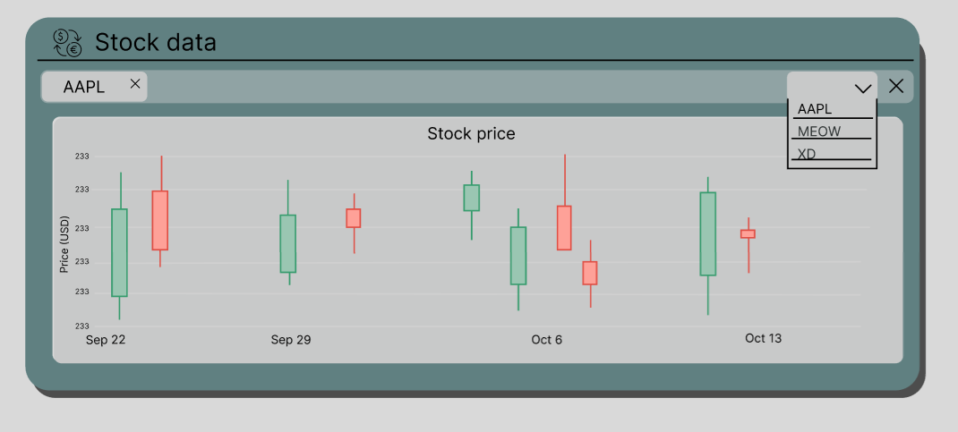
Our ideas for future widgets

Slide 8
User-friendly. Efficient. Innovative.
no_[]_brackets

